Slide 1


ABDELGHAFOR’S
HACKATHON
Local Library Console
Management System

Slide 2
Python files
01
04
book.py
functions.py
02
05
member.py
data_handler.py
03
06
library.py
06
main.py

Slide 3
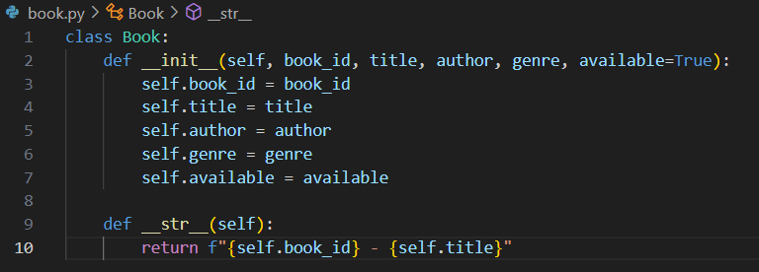
01
book.py
This code defines a class called Book, which represents a book in the library.
The __init__ method initializes a book object with attributes like book_id, title, author, genre, and whether it is available (available defaults to True).
The __str__ method Provides a simple string format for displaying the book's ID and title when the object is printed.

Slide 4
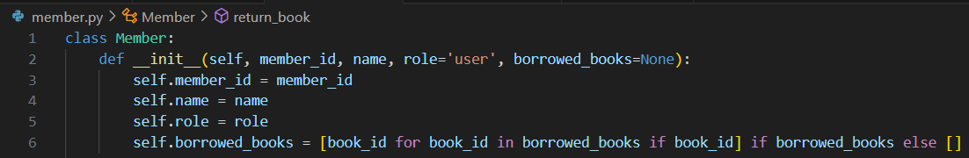
02
member.py
The code defines a Member class, representing a member in the library.
It has attributes like member_id, name, role (defaulting to 'user'), and borrowed_books.
If no books are passed, borrowed_books is set to an empty list.

Slide 5
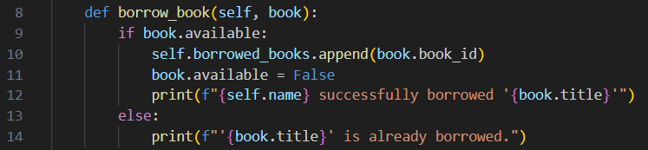
02
member.py
The borrow_book function allows a member to borrow a book if it is available.
It checks the available status of the book. If the book is available, it adds the book_id to the member's borrowed_books list and marks the book as unavailable.
A message confirms the successful borrowing.
If the book is already borrowed, it prints a message informing the member that the book is unavailable.

Slide 6
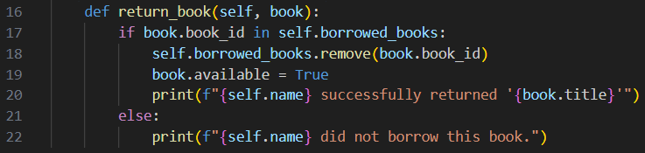
02
member.py
The return_book function allows a member to return a borrowed book.
It first checks if the book_id is in the member's list of borrowed_books. If it is, the book is removed from the list, marked as available again.
A message is printed confirming the return.
If the book wasn't borrowed by the member, a message indicates that they didn’t borrow the book.

Slide 7
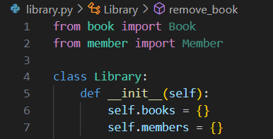
03
library.py
Book and Member classes are imported from their files.
The Library class is created to manage both books and members in the system.
self.books: A dictionary to store books, where each key is the book's ID.
self.members: A dictionary to store members, where each key is the member’s ID.

Slide 8
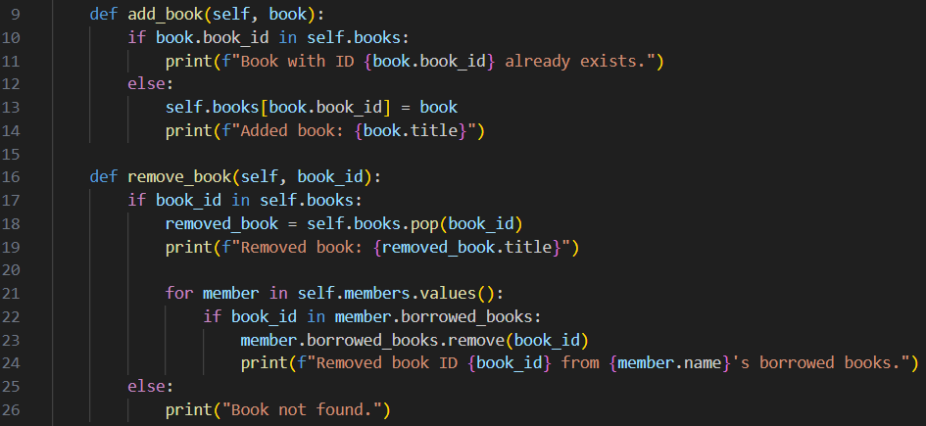
03
library.py
add_book(self, book):checks if a book with the same book_id already exists in the library.
If it does, it prints a message saying the book already exists.
If not, it adds the book to the library's collection and prints a message confirming the addition.
remove_book(self, book_id):checks if a book with the given book_id exists in the library.
If it does, the book is removed from the library's collection, and a message is printed.
Additionally, it checks if any members have borrowed this book and removes it from their lists as well, printing a message for each affected member.
If the book isn’t found, it prints a message saying the book is not in the library.

Slide 9
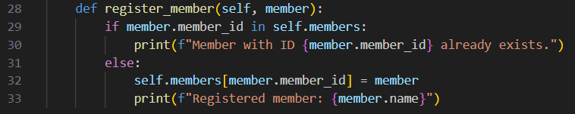
03
library.py
register_member function: adds a new member to the library.
It first checks if a member with the same member_id is already registered.
If the member exists, it prints a message saying the member ID is already taken.
If the member does not exist, it adds the member to the library's list of members and prints a confirmation message with the member's name.

Slide 10

04
functions.py

Slide 11
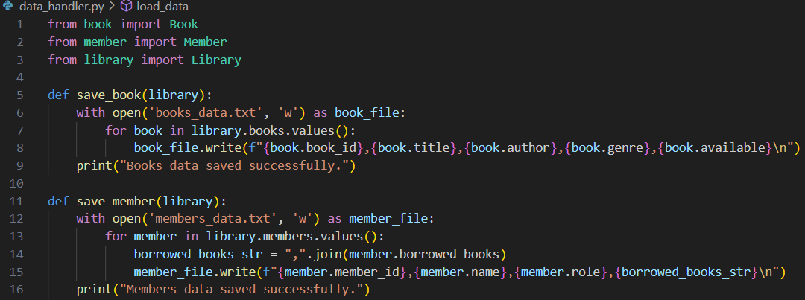
05
data_handler.py
Book, Member, and library classes are imported from their files.
save_book(library):opens a file “books_data.txt” for writing.
Writes details of each book to the file, including book ID, title, author, genre, and availability (each book on a new line).
Prints a message confirming that the book data has been saved.
save_member(library):opens a file “members_data.txt” for writing.
Writes details of each member to the file, including member ID, name, role, and borrowed books (each member on a new line).
Borrowed books are joined into a comma-separated string.
Prints a message confirming that the member data is saved.

Slide 12
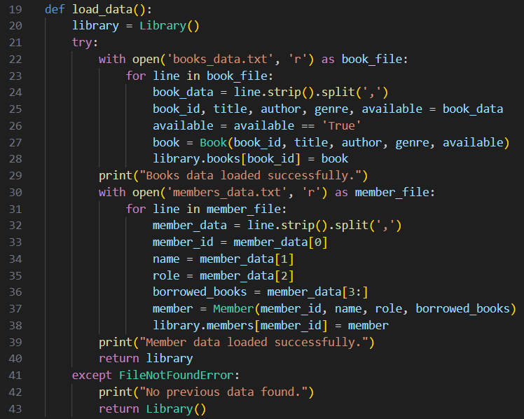
starts by creating a new Library object.
05
data_handler.py
load_data function: starts by creating a new Library object.
Load Books: opens the books_data.txt file and reads each line.
Each line is split by commas to extract book details.
It creates a Book object to add each line to library’s book collection.
A message is printed when the book data is successfully loaded.
Load Members: opens the members_data.txt file and reads each line.
Each line is split by commas to get member details.
It creates a Member object for each line and adds it to the library’s member collection.
A message is printed when the member data is successfully loaded.
If the files are not found, it prints a message and returns a new, empty Library instance.

Slide 13
06
main.py

Slide 14


THANK YOU!
YOUR NAME
YOUR NAME
Elaborate on what you want to discuss.
Elaborate on what you want to discuss.

